Slide 1
Welcome to iMovie!!!
By: Melissa Feilke
Queen of Angels School

Slide 2
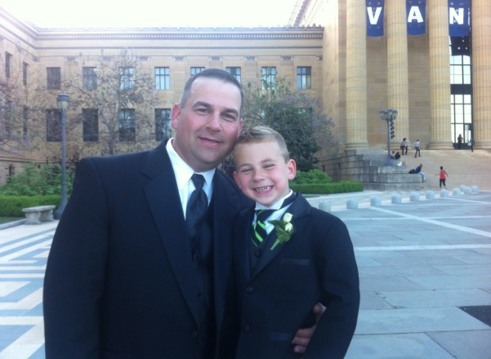
iMovie is an app that can be utilized in the classroom by teachers and students alike - and at home!
How would you like to be able to do this????
Trust me! It's simple to do!!! It just takes some time and practice

Slide 3
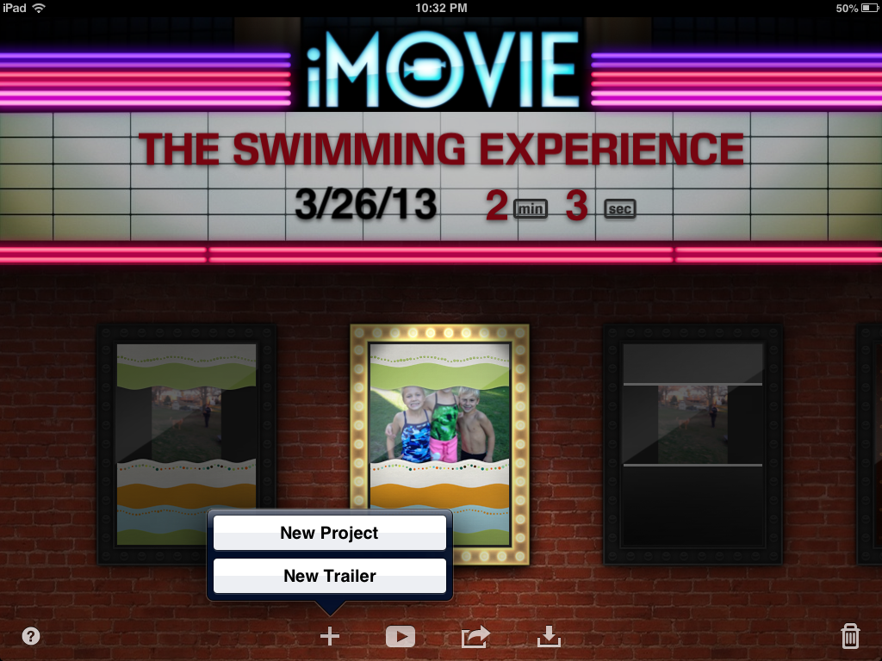
Step 1
Click on the "+"
Choose "New Project"

Slide 4
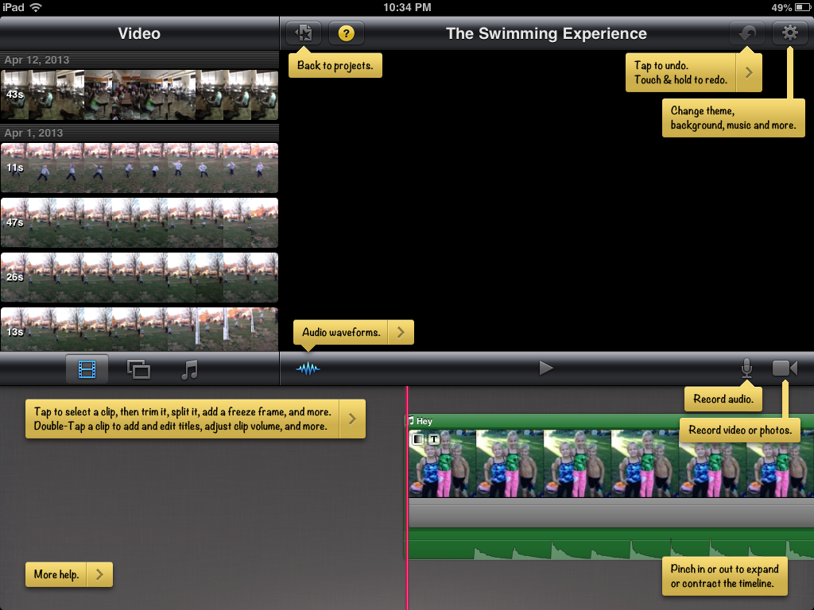
Step 2
insert video, pictures, music, themes
click on the "?" for help
you can also record video/audio directly from iMovie
video
pics
music

Slide 5
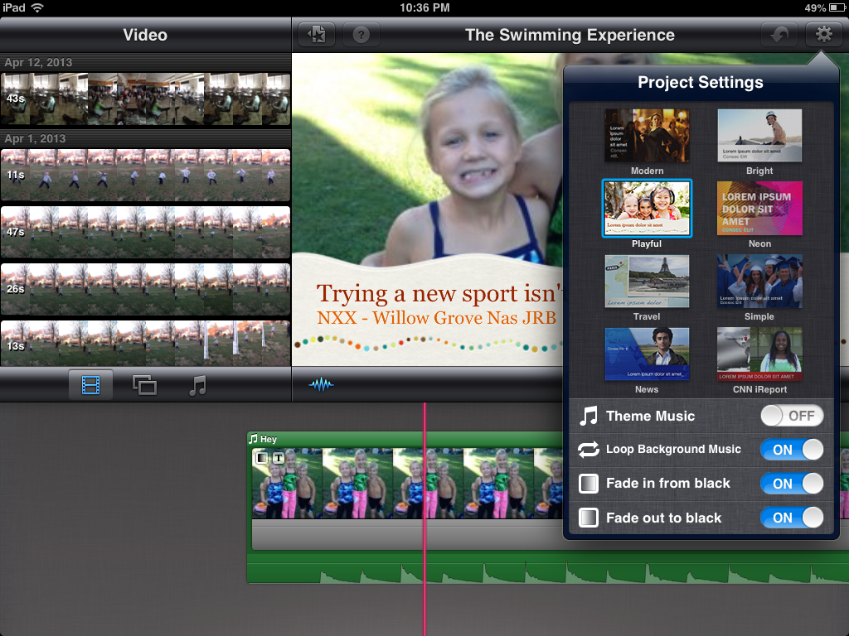
Step 3
settings
start making the iMovie your own!
choose a theme from the settings button

Slide 6
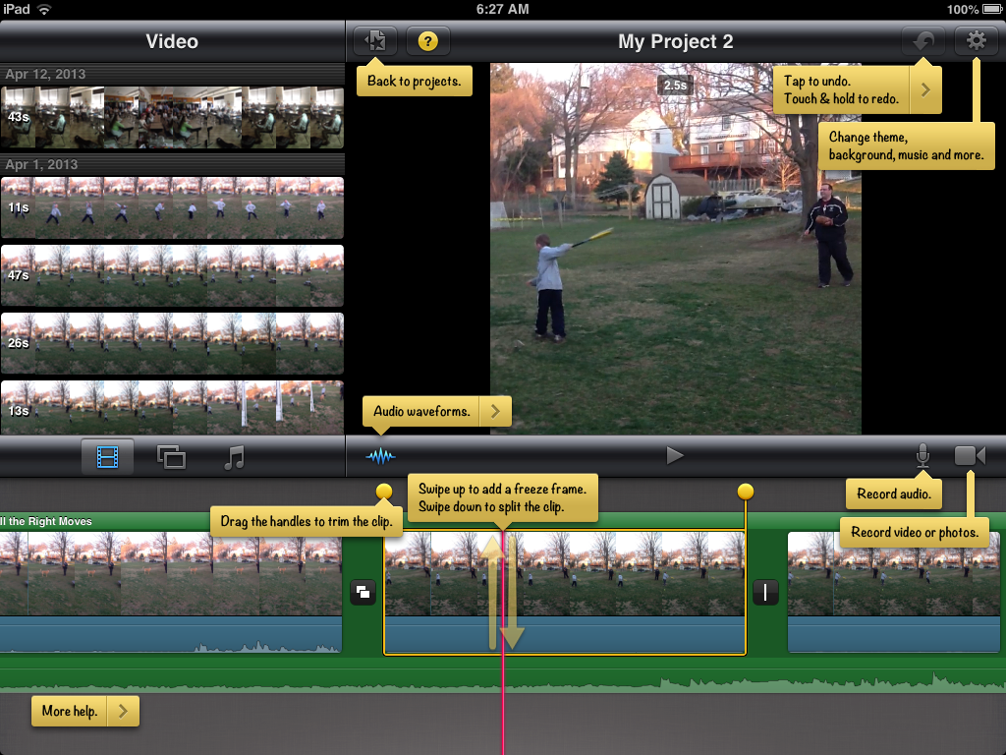
Step 4
trim or freeze frame clips from your videos and pictures
this step takes a little getting used to
just double click on clip until you see yellow outline frame
Drawback: iMovie does NOT allow you to trim music!
copyrights
swipe up for freeze frame; down to split

Slide 7
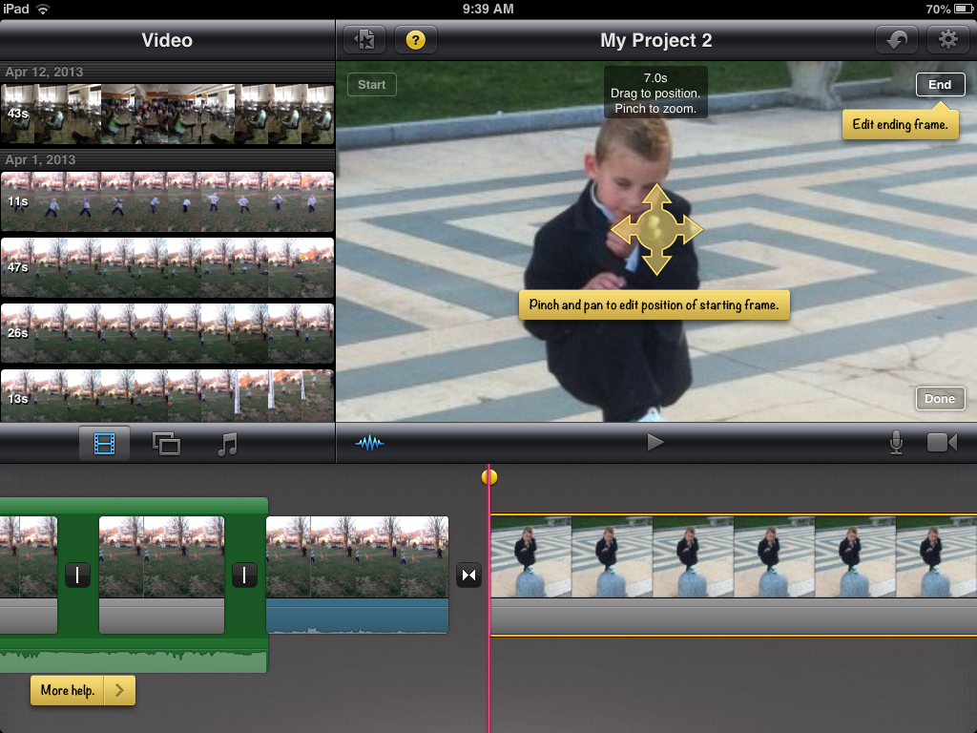
Step 5
all inserted pictures come with "Ken Burns" effect BUT you can also zoom in and edit frame
just pinch!

Slide 8
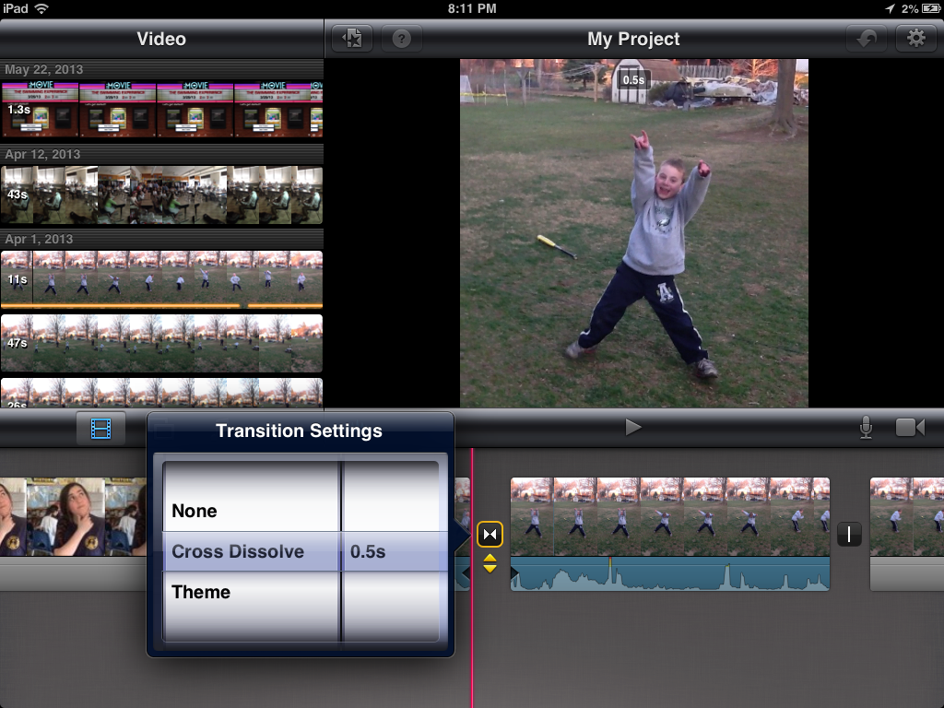
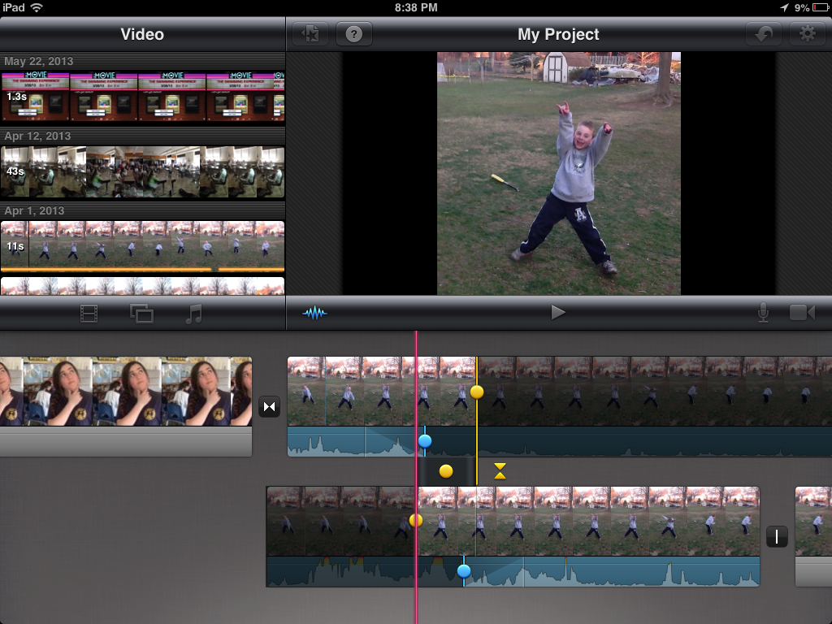
Step 6 -Transitions
click here
allows you to overlap videos

Slide 9
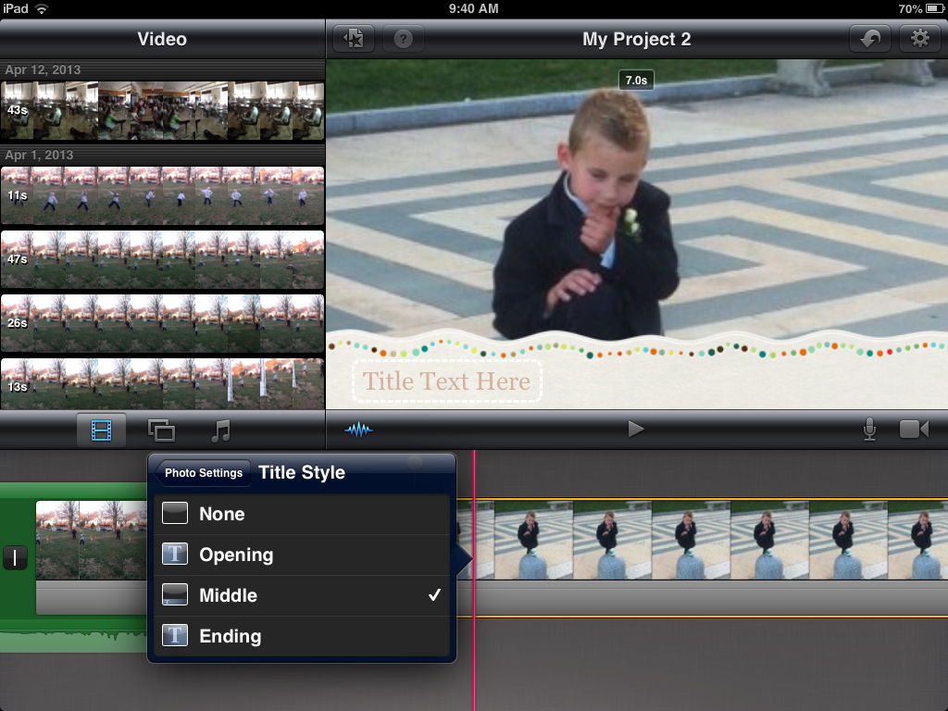
Step 7
Don't forget to add your text!
Style of text depends on theme
double click on clip to bring up yellow frame

Slide 10
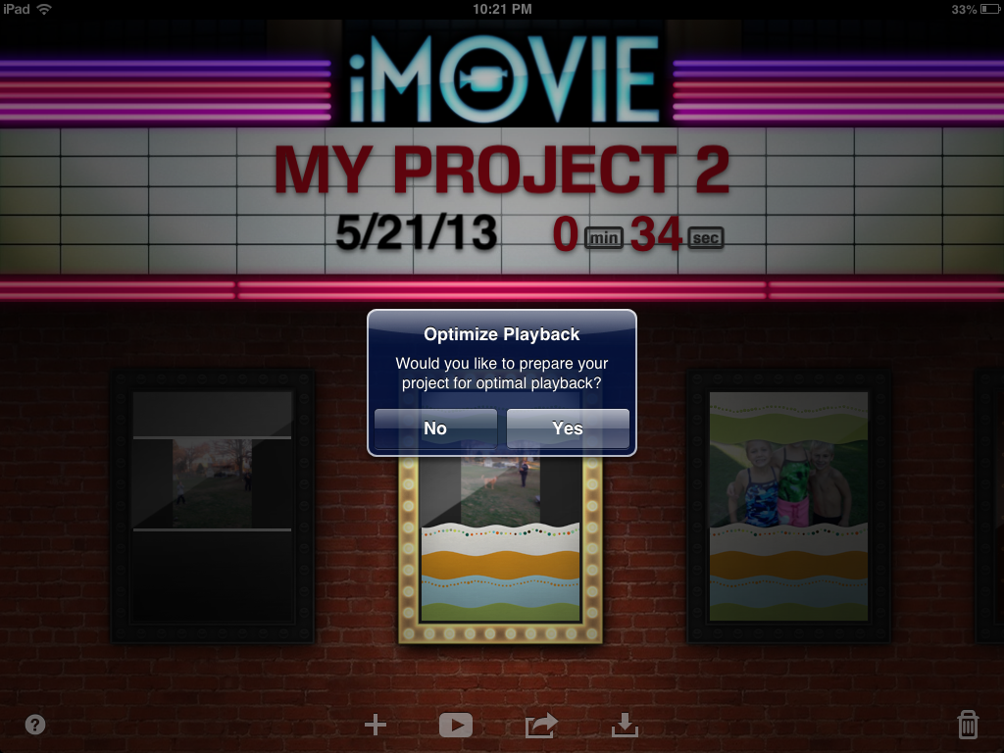
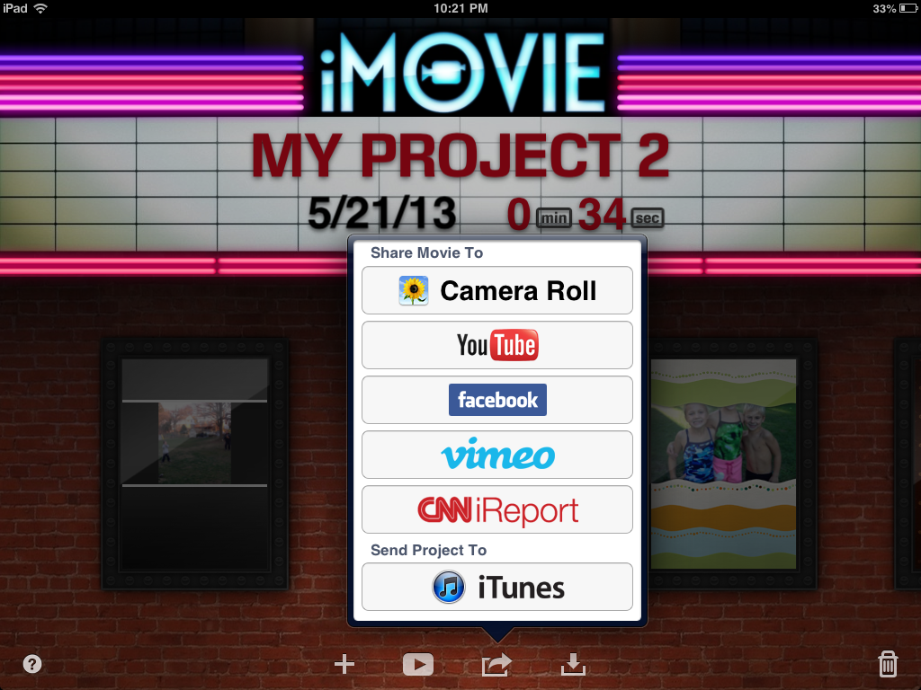
Ok...you've produced and edited this amazing movie...now what???
Add title!!
You upload to YouTube, of course!!!
Step A: Optimize Playback
Step B: Upload to YouTube
when you upload there are 3 settings: Private, Unlisted, and Public

Slide 11
So now...let's see how my homeroom did with iMovie!
Bonus Feature: iMovie Trailer
QOA Marketing Video
By: Kelly Anne Ryan, Tyler Simonds, and Kevin Schleinkofer
By: Hugh Reilly, Julia Domenick, Bridget Dombrowski, and
Zach Krewson
If they can do it, so can YOU!!!

Slide 12
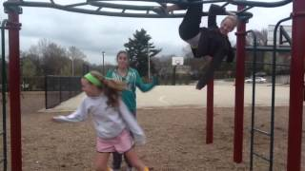
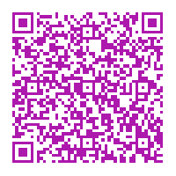
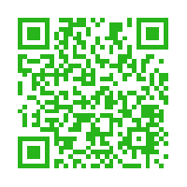
How Can You Use iMovie in the classroom???
picture videos
(animoto.com/app)
digital book summaries
videocast of current events/documentaries
(voicethread.com/app)
flipped classroom/edmodo
(edmodo.com/app)
(khanacademy.com/app)
to recite the Preamble!
record science experiments
historical reenactments
JFK Assassination.mov
student produced math concepts
Good apps to download:
explaineverything
appsgonefree
educreations
showme
And then you can really impress your parents by using qrcodes!
download inigma app

Slide 13
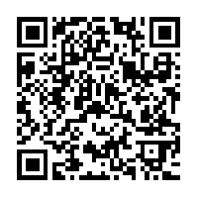
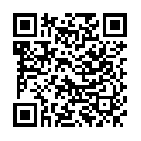
THANK YOU!!!!!
Contact Info: Please feel free to email me with ANY questions :-)
Email: mfeilke@qoaschool.org
Twitter: @mfeilke
Please visit the Tech Academy website to get a link to a website of this presentation to take a survey. Thank you!!!
www.PACTtechacademy.wikispaces.com
http://summertechacademyimovie.weebly.com/links.html
https://sites.google.com/site/mrsfeilkes8thgradehotspot/

